Slide 1
ESSER III
Six Month Review of ESSER III
Student, Parent, Staff and Community Input
Presented by Mr. David Abundis
Senior Director of Federal and State Programs

Slide 2
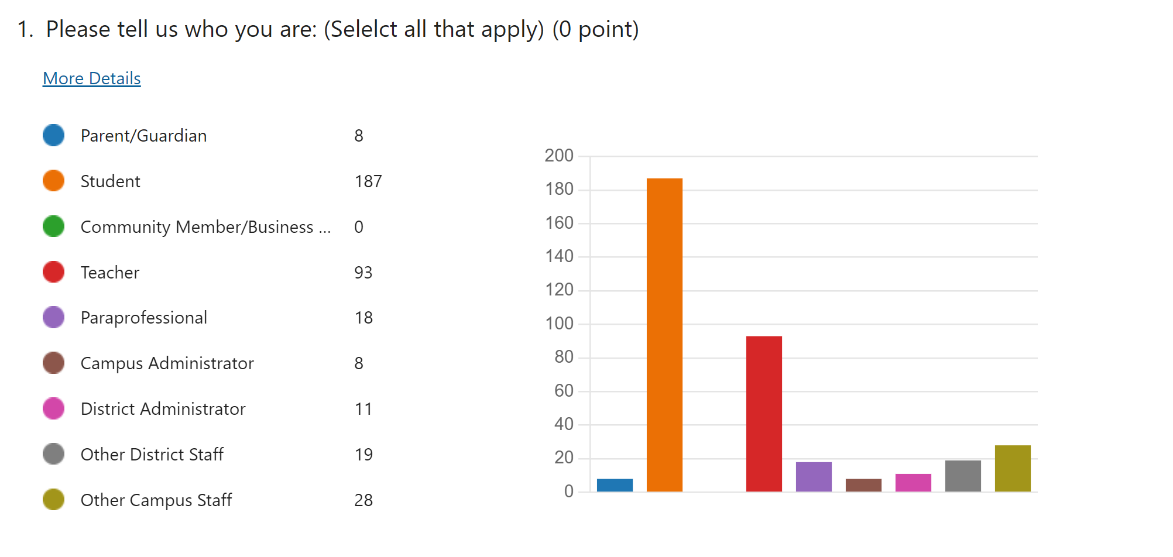
PARTICIPANTS OF SUVEY
Total: 372

Slide 3
How important is it to continue to provide afterschool, evening or Saturday tutoring for students?

Slide 4
How important is it to continue to provide October, January, and June Intersessions?

Slide 5
How important is it to continue to provide educational software programs to our campuses?

Slide 6
Any suggestions on additional resources the district can provide our campuses to meet the Academic needs of our students?
Better or faster WIFI
Reading
Apps, books, libraries*, big books, programs, materials
Math
Delta math, Kahoot, Gimkit, Quizizz, apps, materials
Faster and reliable Internet/Connectivity/Network
Small groups, one-to-one support, and tutors

Slide 7
How important is it to continue to provide individual and small group counseling sessions for our students?

Slide 8
How important is it to continue to provide additional counselors/social workers?

Slide 9
How important is it to provide social emotional curriculum on campuses?

Slide 10
Any suggestions on how we can continue to support our students’ well-being socially and emotionally?
Protected time for Counselors and Social workers to work with students and curriculum
Social workers at all campuses
More SEL counselors
Fun activities and field trips

Slide 11
How important is it to continue sanitation protocols at our campuses?

Slide 12
Any suggestions on how we can continue to keep our students and staff safe from the corona virus?
Continue
Continue to clean and sanitize the schools and especially high touch areas
Mask and hand
Mask and hand sanitizer
Bring back
Bring back COVID testing

Slide 13
THANK YOU

